Slide 1
Pandas Workshop

Slide 2

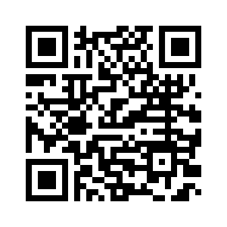


Computer Science Club
Go straight to our FB Events page!
Check us out!
EM 110 - Duck Lounge
Engineering Maths Building

Slide 3
Kaurna Acknowledgement
We acknowledge and pay our respects to the Kaurna people, the traditional custodians whose ancestral lands we gather on. We acknowledge the deep feelings of attachment and relationship of the Kaurna people to country and we respect and value their past, present and ongoing connection to the land and cultural beliefs.

Slide 4

What is Pandas
Pandas is an open-source Python library that provides high-performance, easy-to-use data structures and data analysis tools.
It is built on python and numpy so supports most python and numpy features and supports most standard features of the library.

Slide 5
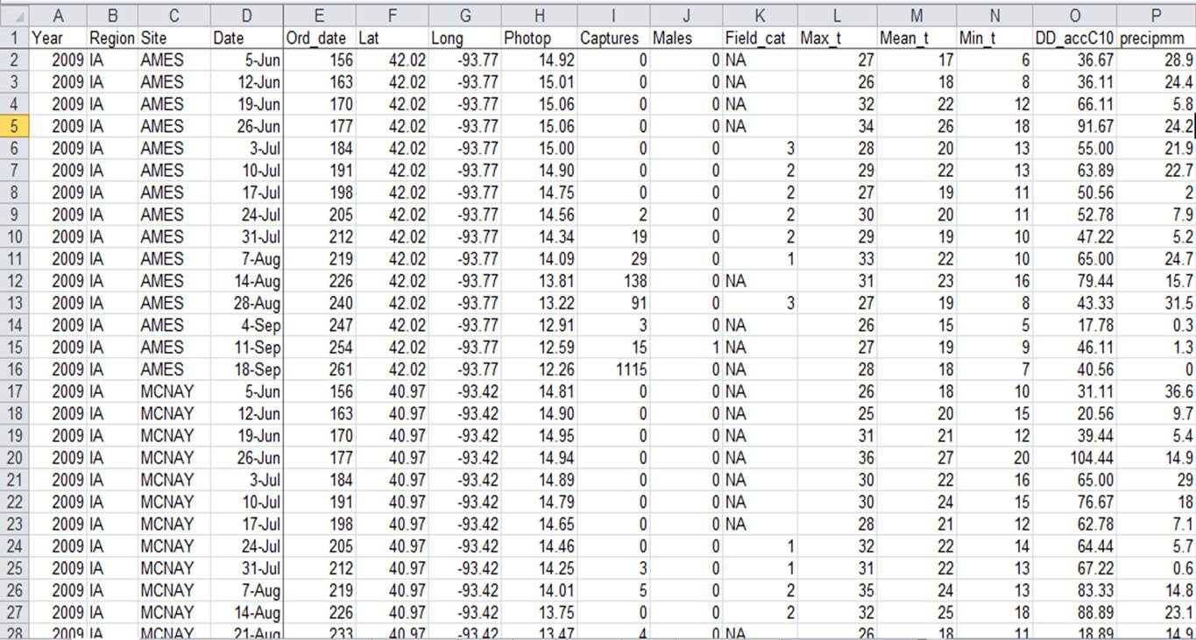
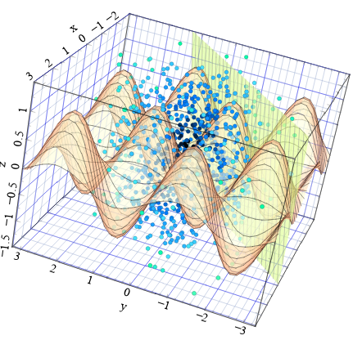
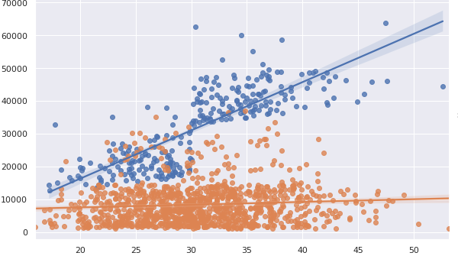
Brief Introduction to Data Science
But behind every beautiful visualisation there is messy raw data that needs to be cleaned
Data Science is mostly focused on the exploration of data and finding trends within the data.

Slide 6
Why Pandas?
Pandas helps turn messy data from unusable to great visualisations and
Prediction models.
*pandas doesn’t directly create the visualisations

Slide 7
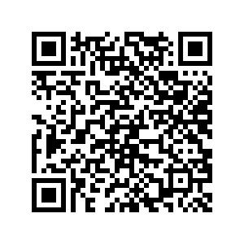
Invite to Notebook
For this demo we will be using Google Collab(a virtual python environment). The QR code bellow will lead you to the notebook that we will be using for the workshop.
https://colab.research.google.com/github/compsci-adl/pandas-workshop/blob/main/workshop.ipynb
Check discord announcement made prior
Check CS-club github for link

Slide 8
Conclusions
This workshop was just a basic overview of the most common functions.
If you are interested in learning more about learning about data science or machine learning:
Pandas / numpy / matplotlib
numpy / math concepts
math concepts / numpy / sklearn
Tensorflow / opencv

Slide 9
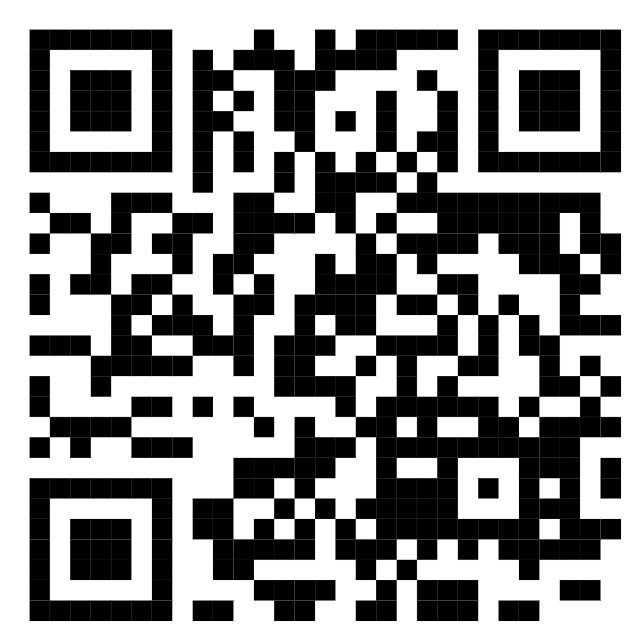
Please give us some feedback on our event! We would really appreciate it!

